Slide 1





Smile.
Your life
just got easier.
Notes:
Smile…..Your life just got easier.
Cigna offers customers “best in class” dental program.
What does that mean for you?

Slide 2
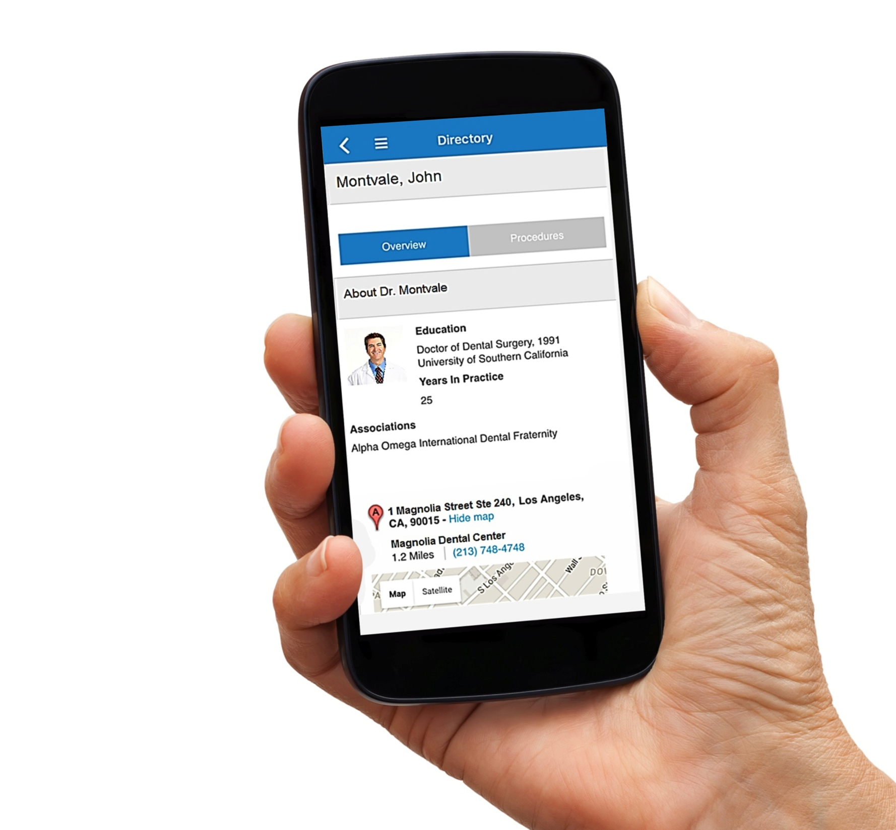
Introducing
Cigna Dental
with new
technology
These myCigna.com screens are still in development and are not the final versions. Actual features may vary.
Notes:
Cigna empowers employees with a industry leading and truly differentiated consumer experience to get the most out of their dental plan. We help maximize the value of your employee’s plan with the same consumer transparencies and tools they have come to expect in other aspects of their lives.
We work to make it as easy as possible for customers to use their plan as well as avoid cost surprises with industry leading tools that help reduce costs while also earning some of the highest member satisfaction ratings in the industry.
Our unique engagement platform is only available for our Dental PPO clients at this time:
Provides an opportunity to offer an enhanced customer experience, with the ability for customers to shop for services by price, compare dentists, review benefits and book appointments online
Increases customer utilization of in-network providers
Promotes provider engagement -Reduces costs to the customer, client and Cigna by informing customer on benefits of using network providers.
Note: DHMO is still in the plan going forward.

Slide 3

Find and compare more than [xxx] dentists in the [name] area
See costs for procedures
Get reminders for appointments and care
These myCigna.com screens are still in development and are not the final versions. Actual features may vary.
Notes:
Find and compare more than [XXX] dentists in the [city name] area.
See costs for procedures
Get remainders for appointments and care.

Slide 4
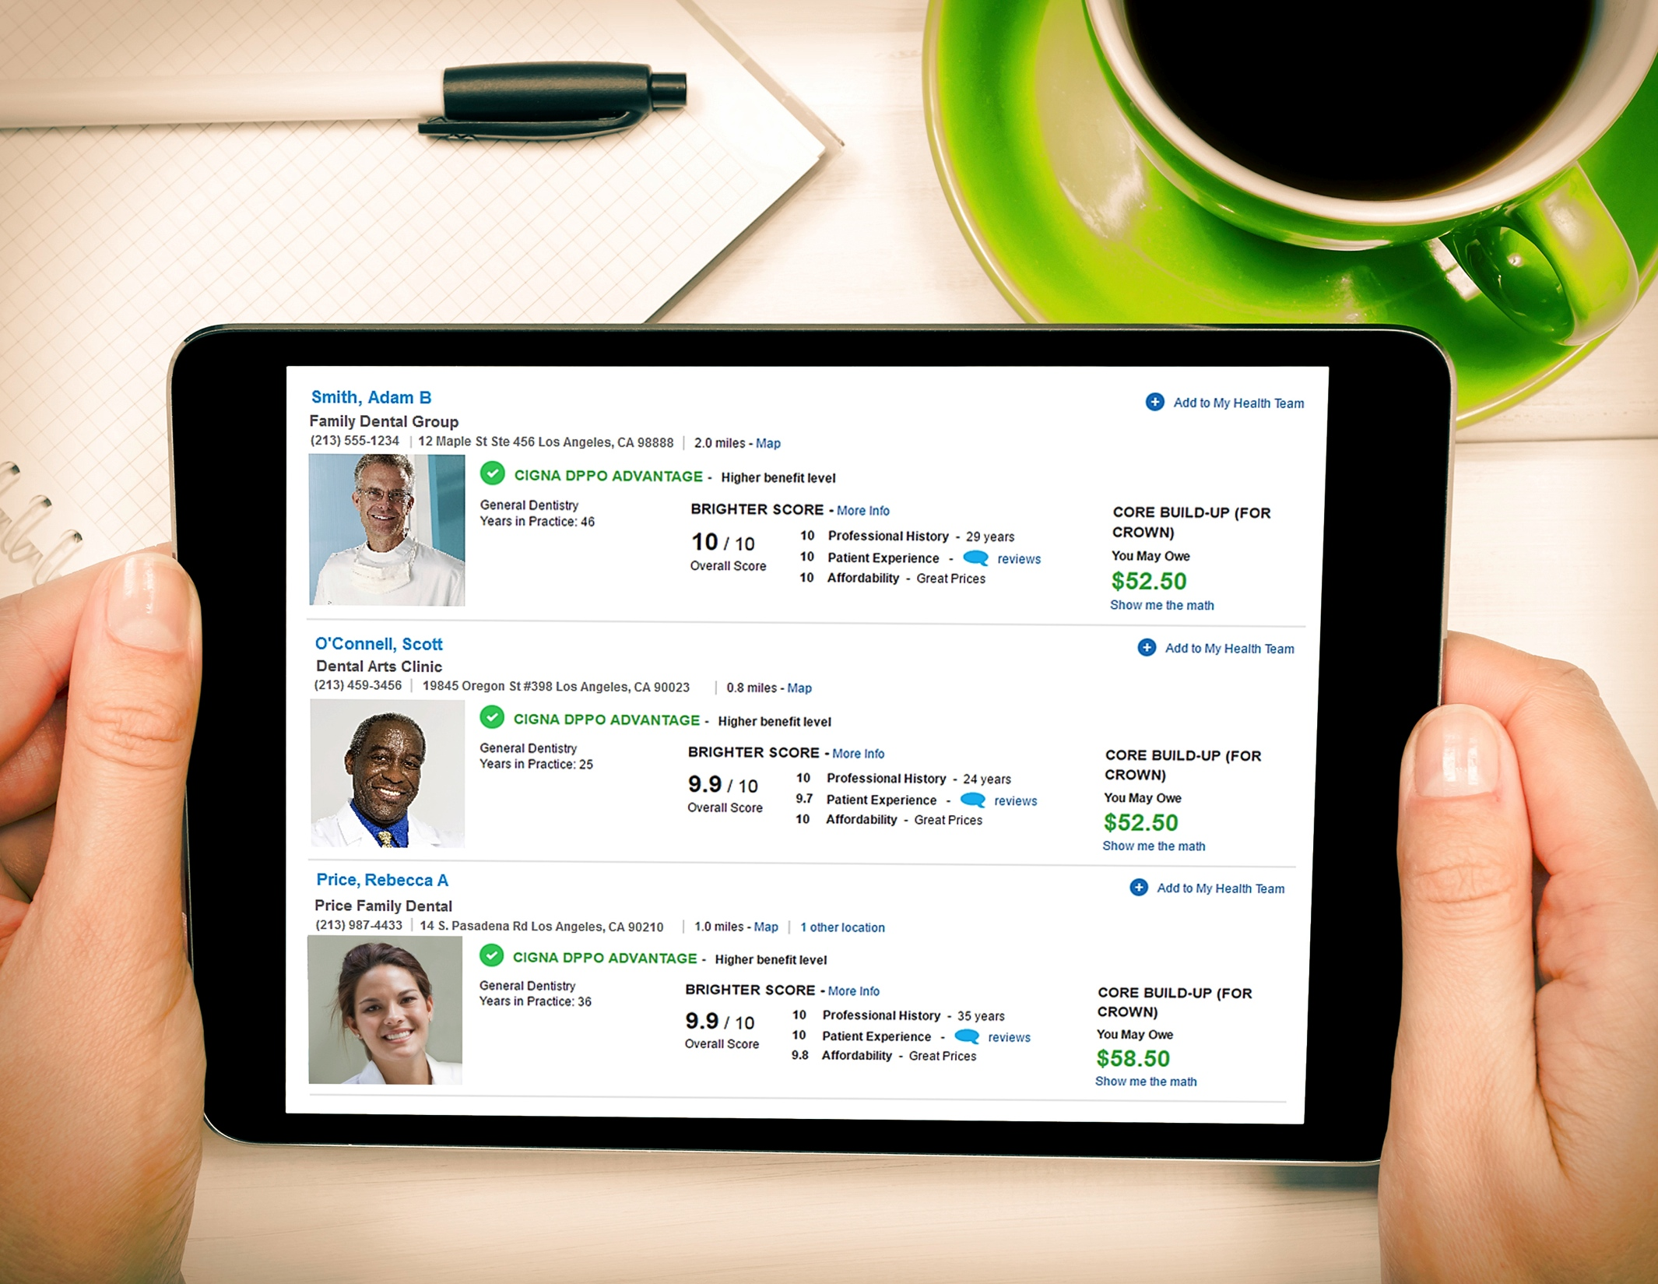
Compare dentists on price,
patient experience, location
These myCigna.com screens are still in development and are not the final versions. Actual features may vary.
Notes:
Our online tool allows our customers to:
-Comparison shop for dentists by price, efficiency, patient satisfaction & location.
A dentist detail page provides deeper insight of a given practice, showing:
Education level
Years in practice
Appointment scheduling
Videos
Photos
Provider locations are displayed, showing geographic location as well as network.

Slide 5
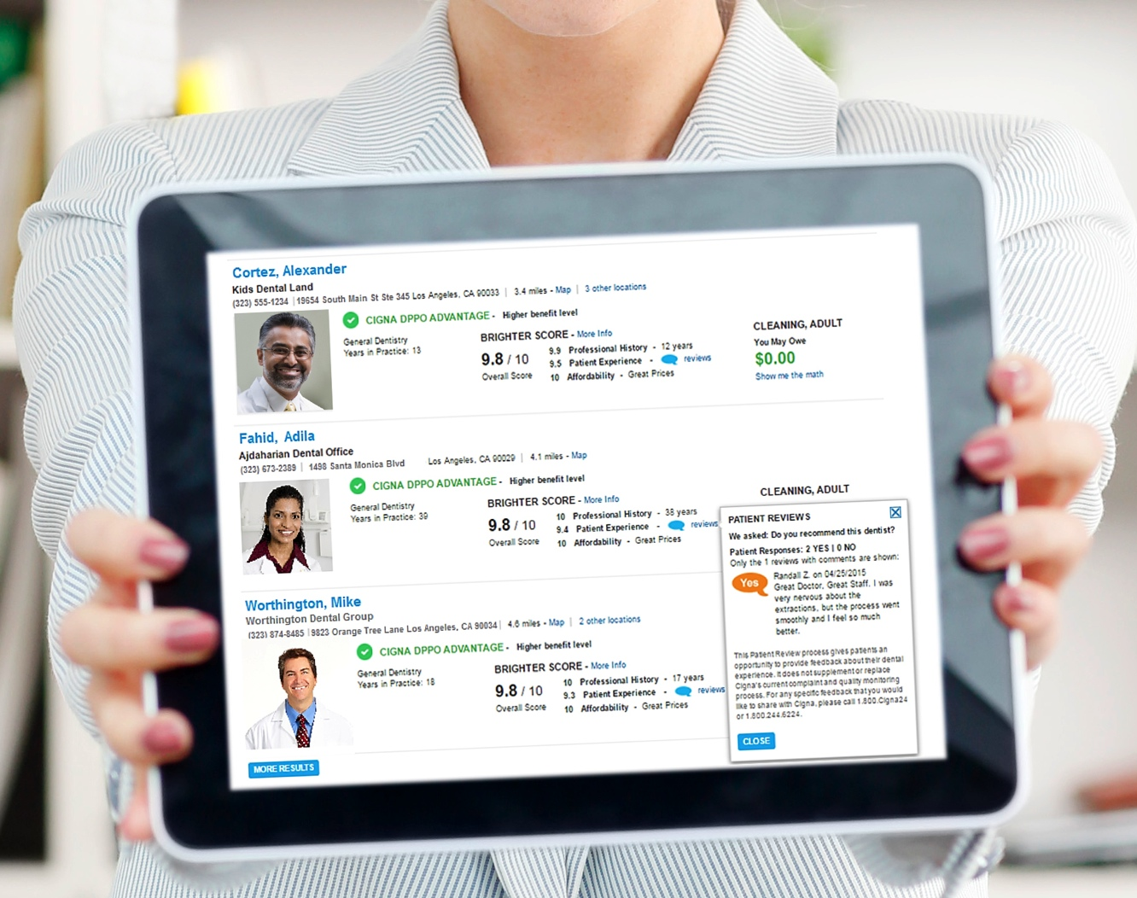
Share reviews and ratings with Brighter ScoreTM technology
Notes:
Cigna is the first and only carrier to offer the Brighter ScoreTM technology which brings innovative online customer experience tools to the dental-related portions of myCigna.com. This will help build the kind of patient-dentist relationships that increase the value of dental benefits for customers and providers alike.
-The Brighter ScoreTM will easily note the best provider for the customer that measures affordability, experience and patient satisfaction.
-Access certified patient reviews of dentists.
The Brighter Score is the healthcare industry's first comprehensive guide for customers to compare the overall value offered by our different network providers, a provider's Brighter Score is comprised of three key attributes:
1. Professional History - which measures a provider's professional and educational background including a review of their dental license history and advanced training they have received;
2. Patient Experience - which measures feedback from verified-patients regarding their experience at the provider, provider’s online reputation, and the amenities their practices features;
3. Overall Affordability - which measures the estimated out-of-pocket costs you will have to pay that provider for the most common procedures that patients receive.

Slide 6
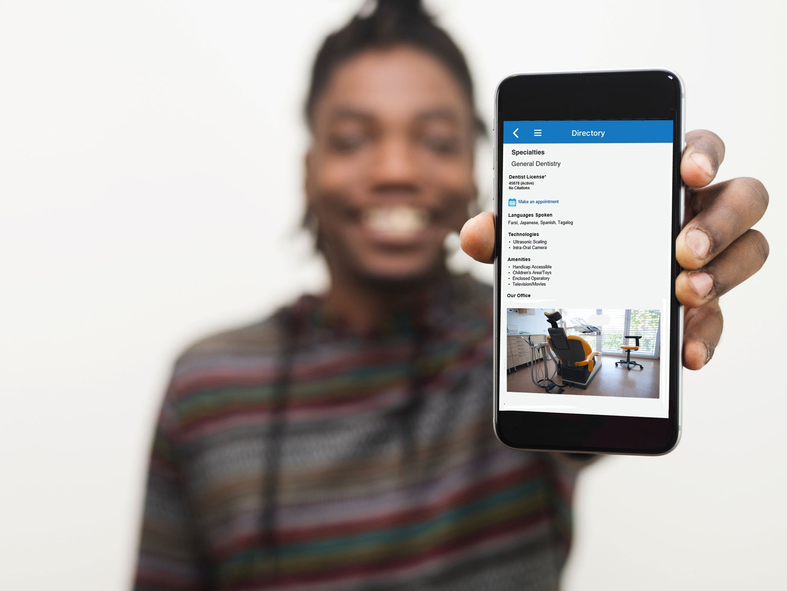
Make your
appointments online
These myCigna.com screens are still in development and are not the final versions. Actual features may vary.
Notes:
Set appointments online once a dentist is chosen.
View more information about network dentists, including photos, videos, office amenities, associations, certifications and more.

Slide 7
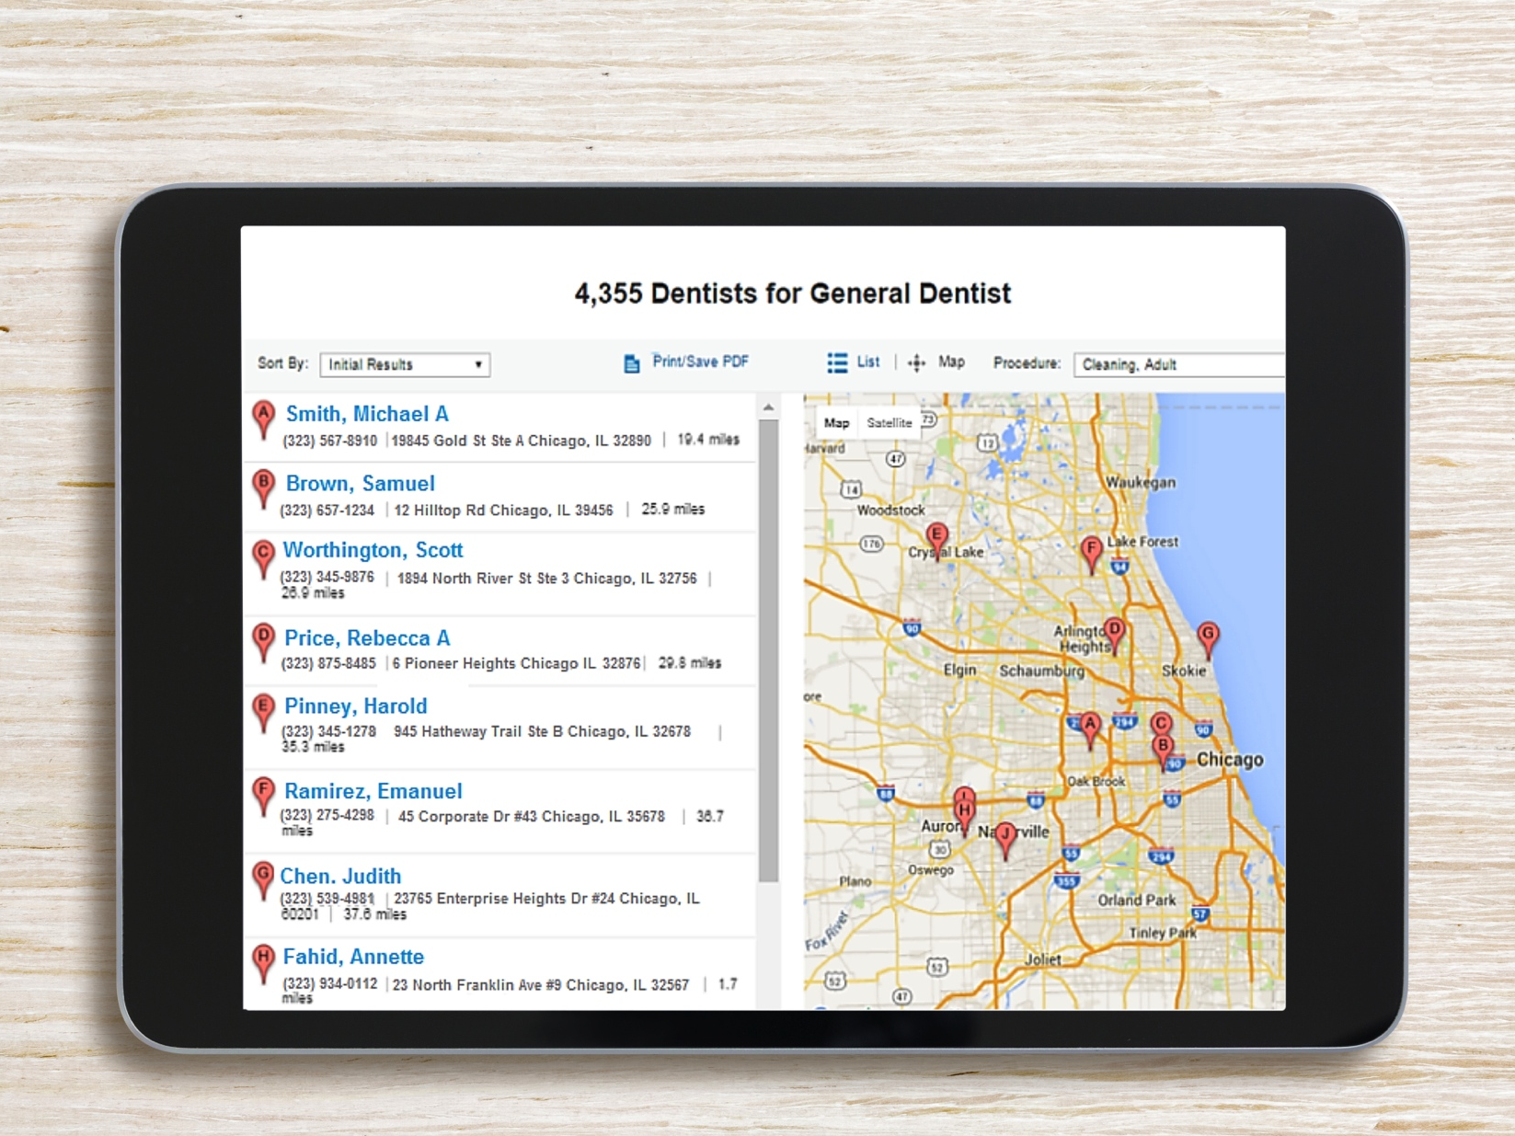
We are where you are and
we have who you want.
These myCigna.com screens are still in development and are not the final versions. Actual features may vary.
Notes:
We are where you are and we have who you want.
<insert copy about client detailed location(s) and our providers>

Slide 8
A BETTER USER EXPERIENCE
FROM CIGNA DENTAL
IS HERE!

Slide 9
Brighter features may vary by Cigna Dental product or customer plan. Cigna makes no representations or warranties as to the quality or accuracy of the information or services of Brighter. The Brighter Score is not a guarantee of the quality of care that will be delivered to individual customers. Customers are encouraged to consider all relevant factors and to speak with their treating dentist when choosing where to receive dental care.
These myCigna.com screens are still in development and are not the final versions. Actual features may vary.
Product availability may vary by location and plan type and is subject to change. All group dental insurance policies and dental benefit plans contain exclusions and limitations. For costs and complete details of coverage, contact your Cigna representative.
The term “DHMO” is used to refer to product designs that may differ by state of residence of enrollee, including but not limited to, prepaid plans, managed care plans, and plans with open access features. The Cigna DHMO is not available in the following states: AK, HI, ME, MT, NH, NM, ND, PR, RI, SD, VI, VT, WV, and WY.
All Cigna products and services are provided exclusively by or through operating subsidiaries of Cigna Corporation. Cigna Dental PPO plans are insured or administered by Cigna Health and Life Insurance Company (CHLIC) or Connecticut General Life Insurance Company (CGLIC) with network management services provided by Cigna Dental Health, Inc. (CDHI) and certain of its subsidiaries. In Texas, the insured dental product is referred to as the Cigna Dental Choice Plan, and this plan uses the national Cigna Dental PPO network. Cigna Dental Care (DHMO) plans are insured by Cigna Dental Health Plan of Arizona, Inc., Cigna Dental Health of California, Inc., Cigna Dental Health of Colorado, Inc., Cigna Dental Health of Delaware, Inc., Cigna Dental Health of Florida, Inc., a Prepaid Limited Health Services Organization licensed under Chapter 636, Florida Statutes, Cigna Dental Health of Kansas, Inc. (KS & NB), Cigna Dental Health of Kentucky, Inc. (KY & IL), Cigna Dental Health of Maryland, Inc., Cigna Dental Health of Missouri, Inc., Cigna Dental Health of New Jersey, Inc., Cigna Dental Health of North Carolina, Inc., Cigna Dental Health of Ohio, Inc., Cigna Dental Health of Pennsylvania, Inc., Cigna Dental Health of Texas, Inc., and Cigna Dental Health of Virginia, Inc. In other states, Cigna Dental Care plans are insured by CHLIC, CGLIC, or Cigna HealthCare of Connecticut, Inc., and administered by CDHI. Policy forms: OK - Indemnity/DPPO: HP-POL99 (CHLIC) & GM6000 ELI288 et al (CGLIC); DHMO: HP-POL115 (CHLIC), GM6000 DEN201V1 & GM6000 DEN200V1 (CGLIC); TN - Indemnity/PPO - HP-POL69/HC-CER2V1 et al, DHMO - HP-POL134/HC-CER17V1 et al (CHLIC). The Cigna name, logo, and other Cigna marks are owned by Cigna Intellectual Property, Inc. All models are used for illustrative purposes only.
886521 04/16 © 2016 Cigna. Some content provided under license.

